Slide 1
What is IAM?
Enables you to securely control access to AWS services and resources for your users.
Manage IAM users/groups and their access
Manage IAM roles and their permissions
With AWS IAM you get to control who can do what in your AWS environment and from where

Slide 2
IAM Introduction
Manage IAM users/groups and their access.
Users must be created with proper permissions.
Policies are written in JSON (JavaScript Object Notation)
Root account should never be used (and shared)

Slide 3
IAM Introduction
Root in AWS is the same as Root in Windows/Linux
Password Policies
Manage Access Keys
Fine grained control of users, groups, roles, and permissions to resources
IAM has a global view.
MFA (Multi Factor Authentication) can be setup
IAM has predefined “managed policies”

Slide 4
IAM Federation
Big enterprises usually integrate their own repository of users with IAM
This way, one can login into AWS using their company credentials
Identity Federation uses the SAML standard (Active Directory)

Slide 5
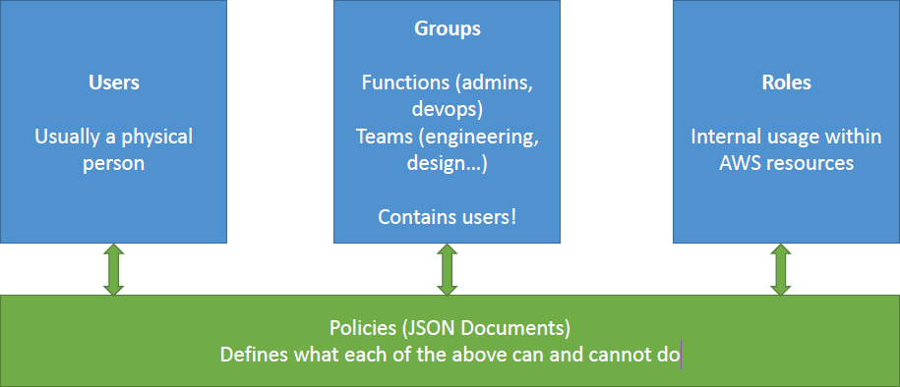
IAM Introduction

Slide 6
IAM Features
Shared access to your AWS account
Granular permissions
Multi-factor authentication (MFA)
Free to use

Slide 7
IAM Brain Dump
Never use ROOT IAM Credentials
One IAM User per PHYSICAL PERSON
One IAM Role per Application
IAM credentials should NEVER BE SHARED
Never use the ROOT account except for initial setup.
Neverwrite IAM credentials in code.

Slide 8
ANY
Questions?

